Slide 1

Why Means Matter-presentation for NYSARH
November 19, 2020
Presenter: Garra Lloyd-Lester, Director of Community and Coalition Initiatives at SPCNY
Garra.Lloyd-lester@omh.ny.gov or 518-810-1453

Slide 2
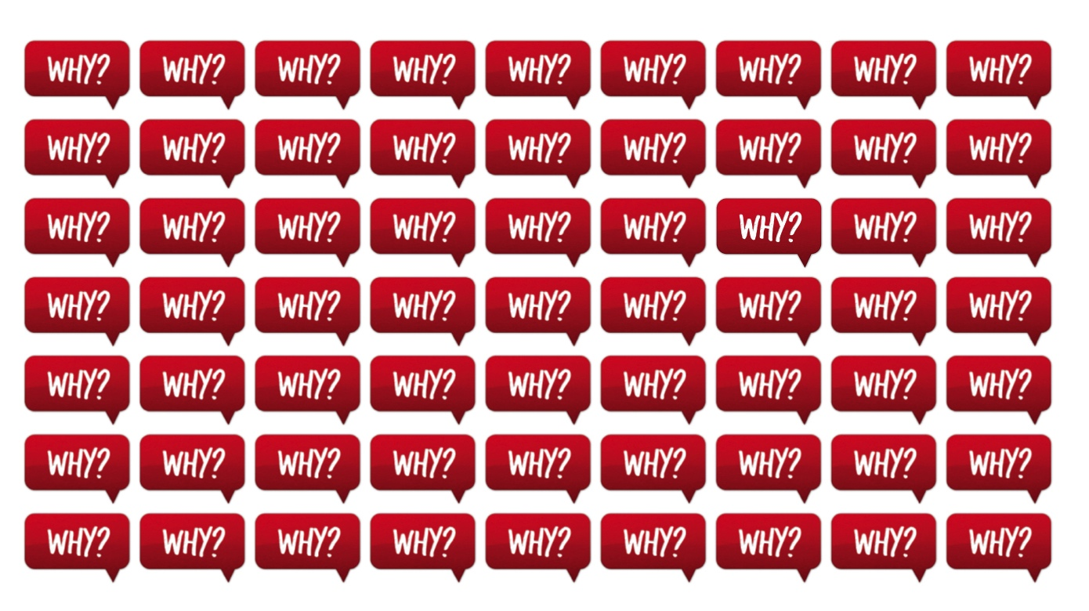
Traditionally suicide prevention has been focused on who takes their life, when, where and especially why

Slide 3
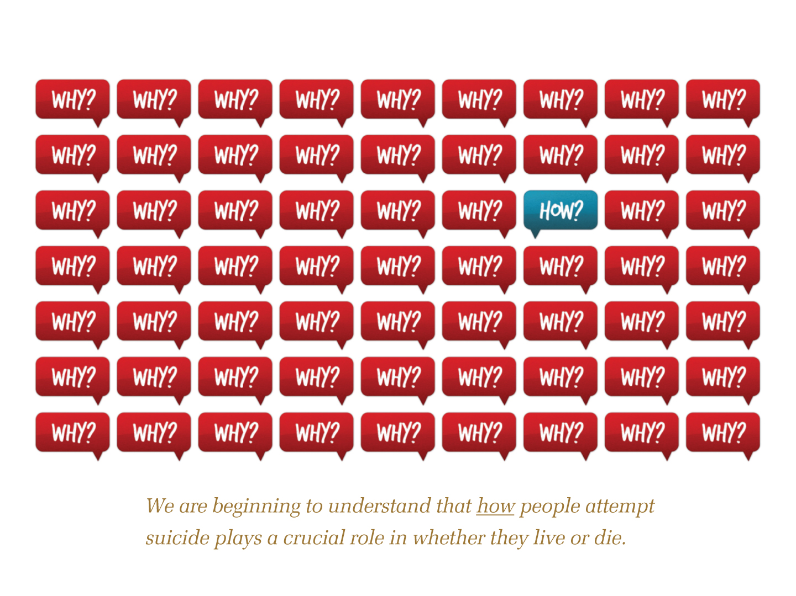
We are beginning to understand that how people attempt suicide plays a crucial role in whether they live or die

Slide 4
Topics covered:
Why Means Matter
Changing the Discourse; Partnering with Gun Owners
Other Lethal Means
Notes:
4

Slide 5


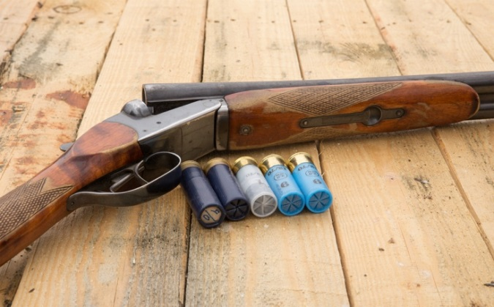
Why Means Matter

Slide 6

Pesticides and Sri Lanka
Mid-1990s: Sri Lanka - one of the top suicide rates in the world.
Pesticides leading method.
The most highly human-toxic pesticides banned in mid-’90s.
Suicide rate dropped 50% from 1996 to 2005.
The drop was driven by a drop in pesticide suicides.
Other methods didn’t drop. Nor did nonfatal pesticide attempts.
The behavior didn’t change. The lethality of the behavior changed.
Gunnell 2007. Int’l J of Epidemiology.
Notes:
6

Slide 7
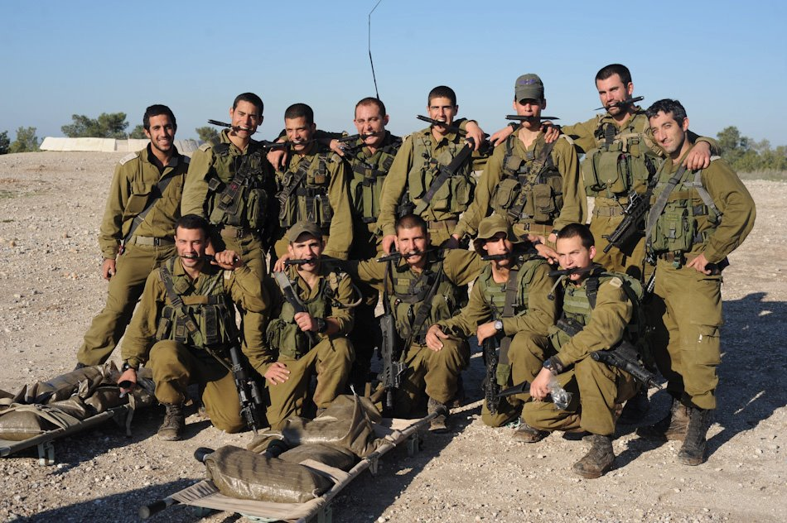
Firearms and Israeli Defense Force (IDF)
Early 2000s, IDF focused on suicide—most by firearm, many on weekends while soldiers were on leave.
2006: soldiers must leave weapons on base during weekend leaves.
Suicide rate decreased by 40%.
Weekend suicides dropped significantly.
Weekday suicides did not.
Lubin, SLTB 2010
Notes:
7

Slide 8
WHY???
How could such a simple change save lives? Why didn’t suicides go up on Monday, or hangings go up on weekends? After all, if you remain committed to ending your life, you can eventually find a way.
Notes:
8

Slide 9
Why Means Matter
Acute phase of suicidal crisis is often brief.
Notes:
9

Slide 10
Suicidal Crises
Acute phase—when you’re actually ready to pull the trigger or swallow the poison—is often brief.
Overwhelming impulse to die often fades. May never recur or may flare up episodically. Rarely a chronic state.
Escalation from misery to ideation to attempt can be fast. Hard to predict; may be triggered by external event.
Period of vulnerability may last a while; but acute suicidal flare-ups are typically brief.
Notes:
10

Slide 11
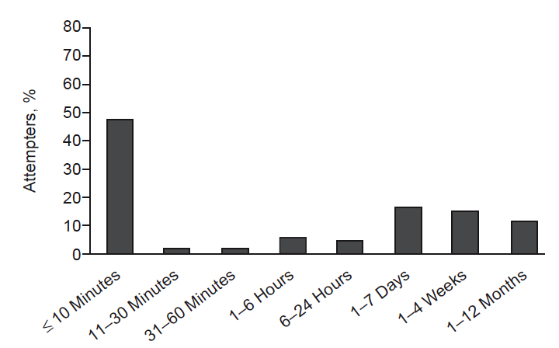
Suicidal Crises
What percent said within 10 minutes of attempting?
People seen in the hospital following a suicide attempt were asked when they had first started thinking about making that attempt.
?
Deisenhammer 2009

Slide 12
48% said within 10 minutes of attempting.
Most people who become suicidal have struggled with ongoing, underlying problems. The movement from suicidal idea to attempt can be rapid and unpredictable.
Notes:
48% said within 10 minutes of attempting.
Half of attempts occur with little deliberation or planning. This doesn’t mean the attempt occurred out of the blue. Most people who become suicidal have struggled with ongoing, underlying problems. But the movement from suicidal idea to attempt can be rapid, which makes it very hard to predict or to pick up in screening.

Slide 13
Why Means Matters for health care providers…
Characteristics of Completed Suicides-70% were seen by a primary care or mental health provider within 30 days of suicide. Other estimates are as high as 83% for health care contacts*
lethal means counseling may occur for less than half of ED patients with suicide risk**
*https://www.psychiatrictimes.com/view/characteristics-completed-suicides
** http://www.ncbi.nlm.nih.gov/pubmed/26989850
Notes:
48% said within 10 minutes of attempting.
Half of attempts occur with little deliberation or planning. This doesn’t mean the attempt occurred out of the blue. Most people who become suicidal have struggled with ongoing, underlying problems. But the movement from suicidal idea to attempt can be rapid, which makes it very hard to predict or to pick up in screening.

Slide 14
…continued
Interventions by healthcare providers can affect a patient’s storage of firearms which in turn can substantially reduce risk for suicide or other firearm-related injury*
Patients who received a physician’s verbal or written recommendation were three times more likely to make safe changes in firearms storage practices than patients who did not receive counseling**
For every 2.5 gun-owning parents who received a pediatrician’s counseling and free cable locks, one parent reported using the cable locks six months later***
*Grossman, D. C., Mueller, B. A., Riedy, C., Dowd, M. D., Villaveces, A., Prodzinski, J., et al. (2005). Gun storage practices and risk of youth suicide and unintentional firearm injuries. JAMA, 293(6), 707-714
**Albright, T. L. & Burge, S. K. (2003). Improving firearm storage habits: Impact of brief office counseling by family physicians. The Journal of the American Board of Family Practice, 16(1), 40-46.
***Barkin, S. L., Finch, S. A., Ip, E. H., Scheindlin, B., Craig, J. A., Steffes, J., et al. (2008). Is office-based counseling about media use, timeouts, and firearm storage effective? Results from a cluster-randomized, controlled trial. Pediatrics, 122(1), e15-e25.
Notes:
48% said within 10 minutes of attempting.
Half of attempts occur with little deliberation or planning. This doesn’t mean the attempt occurred out of the blue. Most people who become suicidal have struggled with ongoing, underlying problems. But the movement from suicidal idea to attempt can be rapid, which makes it very hard to predict or to pick up in screening.

Slide 15
A Suicide…Robert is a 27 year-old with a drug problem. He recently moved back in with his parents after his girlfriend kicked him out of their apartment. When he stopped going to work, his parents contacted a mental health center and urged him to see a counselor. He refused.
He called his girlfriend, hoping to get back together, but she wouldn’t speak to him. Feeling desperate, he went to the gun cabinet…
…but the guns were gone. He slashed his wrists. His mother took him to the hospital, and he recovered. …or a Life Saved?

Slide 16
Why did he survive?
Notes:
16

Slide 17
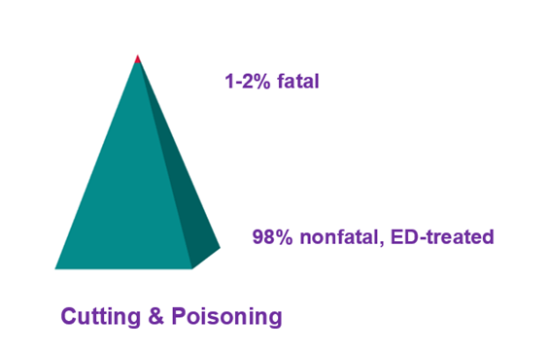

If Robert had used a gun, his odds of dying would have been 9 out of 10.
What are the odds using sharps or overdose?
83-90% fatal
10-17% nonfatal, ED-treated
Firearms
Spicer & Miller, 2000 Based on data from emergency departments and death certificates.
NOTE: We caution against broadly disseminating these specific numbers to the general public. People’s perception that overdose and cutting are more lethal than they usually are probably saves many lives.

Slide 18
Why Means Matter
The acute phase of a suicidal crisis is often brief.
Some methods are far more lethal than others.
Notes:
18

Slide 19
Method Lethality
Method of attempt: one of biggest factors governing whether the person lives or dies.
Intent matters; but means also matter.
As in Robert’s case, the method choice was governed by both intent and ready access.
Ready access is particularly important when attempts occur rapidly with little or no planning.
Notes:
19
Eddelston -

Slide 20
Methods of Self-Harm, U.S.
Overdose/
Poison
12%
Hanging/
Suffocation
26%
Gas 3%
Jump 2%
Sharps 2%
Other 4%
Overdose/Poison
66%
Firearm
51%
Sharps
22%
Suffocation 2%
Firearm 1%
Other 9%
Fatal
Nonfatal
Fatal (Suicide): CDC WONDER (2016) 54% firearm in Oregon Nonfatal: Canner 2016
Notes:
20
Fatal (Suicide): CDC WONDER (2016)
Nonfatal (Inpatient): Canner 2016

Slide 21
Suicide in New York State (2018) by mechanism
Data source: NCHS Vital Statistics System for numbers of deaths. Bureau of Census for population estimates. https://www.cdc.gov/nchs/nvss/deaths.htm
Notes:
Rural definition based on Office of Management and Budget (OMB) metro counties

Slide 22
Lethality of Suicide Method
HIGH
Lethality
LOW
Lethality
Firearm
Jump from very great height
Carbon monoxide
Hanging/suffocation
Overdose/poisoning
Cutting

Slide 23

But Did We Truly Save Robert’s Life?
History of suicide attempt is a risk factor for suicide.
What proportion of people who attempt suicide & survive eventually go on to die by suicide?
75% 45% 25% 10%
Carroll 2014
Notes:
23

Slide 24
Why Means Matter
The acute phase of a suicidal crisis is often brief.
Some methods are far more lethal than others.
>90% of those who attempt will not go on to die by suicide
…A life saved in the short run is usually a life saved.
Notes:
24

Slide 25
Putting time and distance between a suicidal person and a highly lethal method–especially a gun–can save a life.
Notes:
25
To summarize: Suicidal crises are often brief. They are episodic and difficult to predict.
Some methods are far more lethal than others. Ready access plays a role in method choice.
90% of those who attempt and survive do not go on to die by suicide.
Therefore, putting time and distance between a suicidal person and a highly lethal method—especially a gun—can save a life.

Slide 26
Why Firearms Matter Most
Leading U.S. method.
Highly lethal.
Easily accessible if stored at home.
Culturally “acceptable.” Some methods, like fire, are accessible but unacceptable to most U.S. attempters.
Fast, irreversible. No chance for rescue or change of heart once the trigger is pulled. For nearly all other methods except jumps there is an opportunity.
Risk factor. Every U.S. case control study that has examined the issue (15+) finds firearm access a risk factor.

Slide 27
 | High Gun Ownership States* | Low Gun Ownership States**
Population | 31.5 million | 31.3 million
% homes with firearms | 50% | 15%
Suicide attempts (est.) 2008-2009 | 246,000 | 303,400
Suicides 2008-2009
Non-firearm suicides | 4,397 | 4,341
Firearm suicides | ? | ?
Total suicides | ? | ?
* LA, UT, OK, IA, TN, KY, AL, MS, ID, ND, WV, AR, AK, SD, MO, WY
** HI, NJ, MA, RI, CT, NY
Miller, Barber, Azrael, White. Am J Epi 2013, State level attempts from NSDUH; HH gun ownership from 2002 BRFSS
Notes:
27

Slide 28
 | High Gun Ownership States* | Low Gun Ownership States**
Population | 31.5 million | 31.3 million
% homes with firearms | 50% | 15%
Suicide attempts (est.) 2008-2009 | 246,000 | 303,400
Suicides 2008-2009
Non-firearm suicides | 4,397 | 4,341
Firearm suicides | 7,492 | 1,697
Total suicides | 11,889 | 6,038
* LA, UT, OK, IA, TN, KY, AL, MS, ID, ND, WV, AR, AK, SD, MO, WY
** HI, NJ, MA, RI, CT, NY
Miller, Barber, Azrael, White. Am J Epi 2013.
State-level attempts from NSDUH; HH gun ownership from 2002 BRFSS.
Notes:
28

Slide 29
An NVISS study* of firearm suicides among youths ages 17 and under occurring over a two-year period in four states and two counties found that 82% used a firearm belonging to a family member, usually a parent.
When storage status was noted, about two-thirds of the firearms had been stored unlocked.
Among the remaining cases in which the firearms had been locked, the youth knew the combination or where the key was kept or broke into the cabinet.
*http://www.hsph.harvard.edu/hicrc/nviss/documents/Suicide%20Summary%202001.pdf

Slide 30
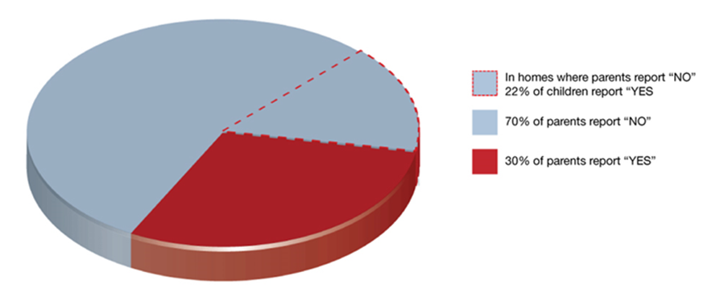
How do young suicide victims get a gun?
Response to the question: “Has your child handled your gun in your home?”*
* Baxley F, Miller M. Parental misperceptions about children and firearms. Arch Pediatr Adolesc Med. 2006;160(5):542-7.

Slide 31
NY and US Suicide Rates*, 2017
*
https://wisqars-viz.cdc.gov/

Slide 32
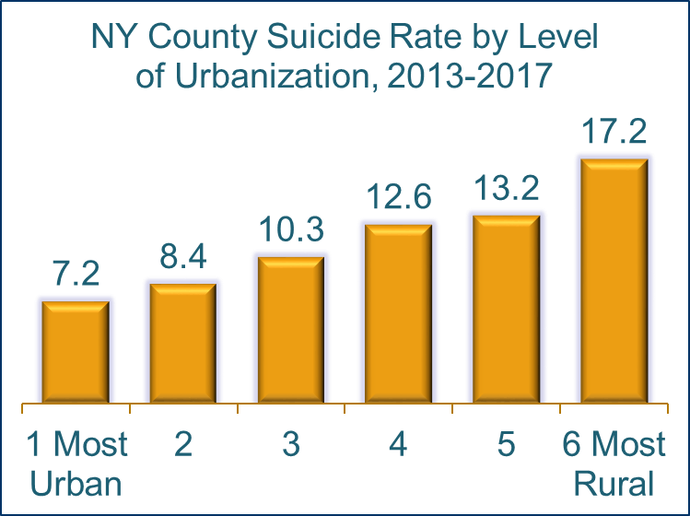
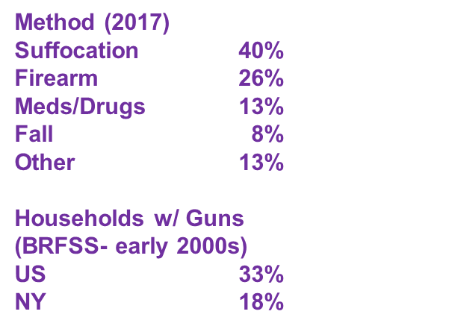
**
*
*https://www.cdc.gov/brfss/index.html
**https://wonder.cdc.gov/

Slide 33

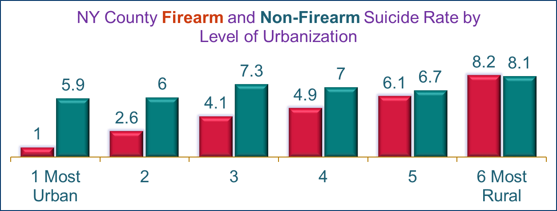
Courtesy of Cathy Barber

Slide 34
Why Means Matter
Changing the Discourse; Partnering with Gun Owners
Other Lethal Means
Notes:
34

Slide 35
Engaging Gun Owners
Ten years ago, most suicide prevention groups weren’t talking about guns and most gun groups weren’t talking about suicide.
And yet gun-owning families were dying by suicide at higher rates than non-gun owners.
They’re not more likely to have a mental illness or to be suicidal; they are more likely to die should they become suicidal.

Slide 36
How do we reach gun owners at risk of suicide?
With an anti-gun agenda? No
That’s like sending an anti-gay group to do a suicide prevention campaign in the gay and lesbian community.
If you don’t trust the messenger, you don’t trust the message. And you’re likely to get the message wrong.

Slide 37
What’s the Message?
Man to his primary care during office visit: “I’m really worried about what happens next; I’m in this funk and it isn’t getting any better, and now with this second DUI, I’m worried my partner might leave me and I could loose my job. I’m thinking maybe I should just pack it in, disappear…permanently.”
After a brief conversation where the PC confirms the patient is considering suicide
Doctor: “thank you for sharing that, it takes a lot of courage to share that information. You have mentioned to me in the past that you like to hunt. Is there somewhere you can store your guns away from home for now, or make them inaccessible until things improve?”

Slide 38
Think about other public health messages. What is some messaging around drunk driving?
Years ago “designated driver” and “friends don’t let friends drive drunk” were unknown concepts.
How do we get that same reach and friends-protecting-friends approach to lethal means safety?

Slide 39
Disseminating the Message to targeted audiences
Clinicians & Healthcare providers
Gatekeepers
  Clergy, social workers, rehab, divorce/defense attorney, etc.
Gun-owning Community
Lethal Means Counseling (build it into the system)
Expand firearm safety to include suicide prevention
Notes:
39

Slide 40
Building It Into the System
Change policies & information systems
State Social Work Association
State Hospital Association
Hospital Administration
Graduate School
Emergency Dept. Social Worker
Notes:
40

Slide 41
Messaging
Pop Quiz:
Is the headline on your brochure:
A “Bringing Down the Deadly Toll of Firearms”
B “Gun Owners Leading the Way on Safety”
Notes:
41

Slide 42

Pushing on an Open Door

Slide 43
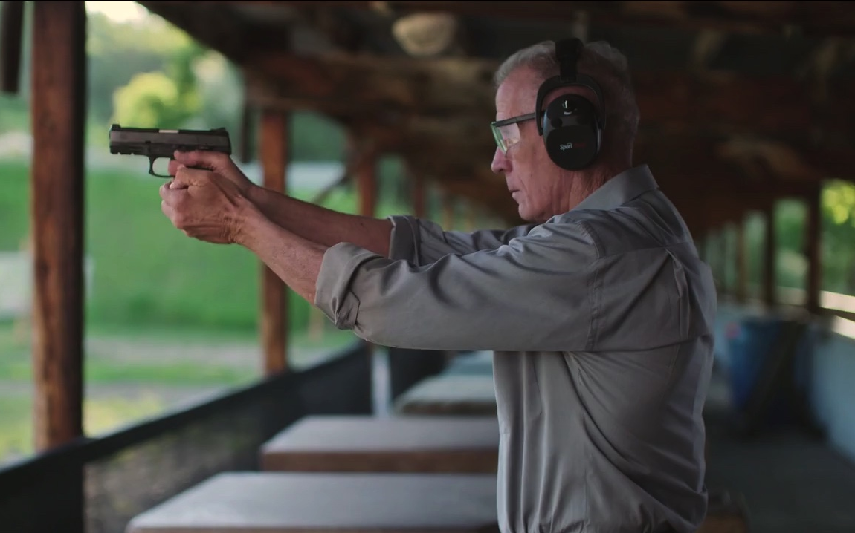
Utah PSA
https://vimeo.com/175761640
Notes:
43

Slide 44
Utah PSA
Tale of resilience and recovery.
Gun-friendly.
Speaks to middle-aged and older white male gun owners.
Normalizes storing guns away from home when struggling.
Doesn’t wait for disclosure of suicidality; catches people further upstream when they’re struggling.
It doesn’t rely on the distressed person asking for help.
Solid “bro” way to support and protect a friend in crisis.
Notes:
44

Slide 45
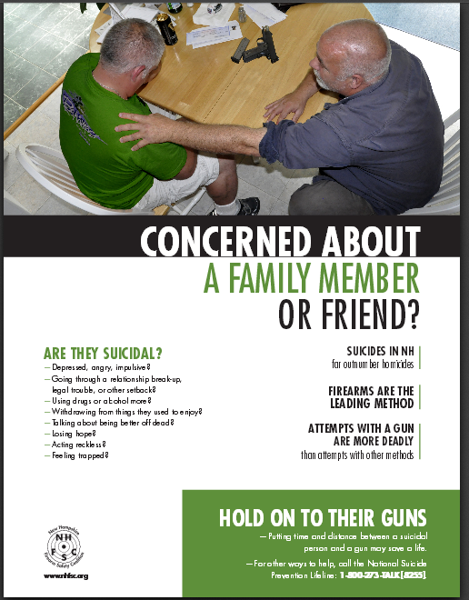

Slide 46
Gun Groups Getting Involved
Maryland Licensed Firearm Dealers Association
Utah Shooting Sports Council
Vermont Federation of Sportsmen’s Clubs
National Shooting Sports Foundation
Second Amendment Foundation
NRA
Individual firearm instructors, retailers, competitive shooters, etc.
Notes:
46

Slide 47
By 2025…
Healthcare providers and gatekeepers– mentioning firearm access is second nature and comfortable for both the clinician and the patient.
Gun-owning community – every firearm safety class, website, brochure, etc., mentions suicide prevention (“Be alert to signs of suicide risk in loved ones and help keep firearms from those at risk until they have recovered.”)
Notes:
47

Slide 48
How do we keep your families safe? Recommendations for families:
Weigh the pros & cons
Move guns out of the home
Store guns securely
Notes:
48

Slide 49
How do we keep your families safe? Recommendations for families:
If you have firearms at home and a household member is suicidal or at risk (e.g. an impulsive teen, a person struggling with depression or drug/alcohol problems or someone going through difficulties like divorce or arrest) consider removing the guns
Notes:
49

Slide 50
How do we keep your families safe? Recommendations for families:
Store guns securely: not having guns at home is safest. But if that isn’t an option,
Store guns locked and unloaded
Store ammunition locked separately
Keep the key or combination secure
Remember, most teenagers know the parents hiding places
Notes:
50

Slide 51
How do we keep communities safe? Recommendations for suicide prevention groups:
Educate providers
Change policy
Expand options
Notes:
51

Slide 52
How do we keep communities safe? Recommendations for suicide prevention groups:
Educate providers
Train providers on how to counsel suicidal or at risk people and their families about guns at home. Many provides currently do not. Visit the means matter website for information about lethal means counseling
Notes:
52

Slide 53
How do we keep communities safe? Recommendations for suicide prevention groups:
Change Policy
Ensure that all suicidal patients and their families are counseled about access to guns
Do this by encouraging professional groups (e.g. state social workers associations, state hospital association etc.) to add lethal means counseling to current suicide prevention protocols
Notes:
53

Slide 54
How do we keep communities safe? Recommendations for suicide prevention groups:
Expand options
Work with local police, public safety group and others to expand options for families who want to temporarily remove guns either permanently or temporarily
Many police departments currently have no policy in place to dispose of or store weapons. Work with them to explore feasible options
Notes:
54

Slide 55
Why Means Matter
Changing the Discourse; Partnering with Gun Owners
Other Lethal Means
Notes:
55

Slide 56
Lethality of Suicide Method
Firearm
Jump from very great height
Carbon monoxide
Hanging/suffocation
Overdose/poisoning
Cutting
HIGH
Lethality
LOW
Lethality
Reduce access
Reduce toxicity
Reduce acceptability & knowledge
Reduce access to most lethal
Notes:
56

Slide 57
Some common Medicines used in Overdose Deaths
Opioids (e.g., oxycodone, methadone, morphine)
Benzodiazepines (anti-anxiety)
Psychiatric medications (antidepressants, antipsychotics, mood stabilizers)
Sleeping medication (diphenhydramine [Benadryl] and prescription)
Over-the-counter pain relievers and cough suppressants
Notes:
57

Slide 58
Messaging Quandary
Lock them all?
  Easy to message; no technical training
  But hard to actually carry through on (think people who may legitimately need one or more Rx)
  Logical possibility of greater harm by substituting more lethal method
Lock some?
  Less risk of lethal substitution
  Remember, a few hundred thousand attempters! If even 5% shifted to a more lethal method: thousands more deaths
  Trickier to message; requires technical knowledge
Notes:
58

Slide 59
A Resources
Breaking Through Barriers: The Emerging Role of Healthcare Provider Training Programs in firearm suicide prevention
HEALTH SYSTEM TARGETS GUN SAFETY TO PREVENT SUICIDE
The Means Safety Messaging for Clinical Staff pocket card provides medical professionals with easily digestible information for talking with Veteran patients about safe storage
Managing Suicide Risk and Access to Firearms: Guidelines for Providers
AFSP’s Firearms and Suicide Prevention education program
Lethal Means Safety Counseling
NYS firearm laws: https://www.nraila.org/gun-laws/state-gun-laws/new-york/, https://lawcenter.giffords.org/gun-laws/state-law/new-york/, https://cdn1.sph.harvard.edu/wp-content/uploads/sites/127/2018/09/State-Laws-Pertaining-to-Temporary-Firearm-Transfer-to-Protect-Persons-At-Risk.pdf

Slide 60
Additional Resources-Veterans and Military focused
New resources to help Veterans understand lethal means safety
The Reducing Firearm & Other Household Safety Risks for Veterans and Their Families brochure provides best practices for safely storing firearms and medications, along with advice for Veterans’ loved ones on how to talk to Veterans about safe storage.
AFSP’s Firearms and Suicide Prevention education program
Veterans, Firearms, and Suicide- THE IMPORTANCE OF LETHAL MEANS SAFETY AS A PREVENTION STRATEGY
Means Matter | Harvard T.H. Chan School of Public Health
Utah projects-‘Is your Safety On?’Teen PSA
Utah Firearm Suicide Prevention Video

Slide 61
Questions?
For more information on suicide prevention efforts across NYS feel free to contact me at:
Garra Lloyd-Lester, Director of Community and Coalition Initiatives at SPCNY
Garra.Lloyd-lester@omh.ny.gov or 518-810-1453

