Slide 1
Using Technology for Connection & Well-being
A Panel Presentation from programs in CT, ME & NH
The New England Rural
Health Association

Slide 2
Thank You To Our Sponsors!

Slide 4
State of Maine, Department of Health and Human Services (DHHS), Maine CDC, Rural Health and Primary Care Program
Who We Serve
Supporting health care infrastructure workforce
quality and access to care
in the State of Maine
Hospitals
Quality improvement
Sustainability
Population Health
3,437 Employees
16 Regional Offices
⅓ of the Population
Safety net services
Primary care
Dental care
Mental health
Health care workforce
Pipeline programs
Shortage designations
Recruitment incentives
Rural health resources
Networks & partnerships
National models
Professional development

Slide 5
Health Merch

Slide 6
www.dartmouthaging.org
A national leader in health services aimed at improving the care and extending the quality of life of older Americans, particularly those living in rural areas. We offer a wide range of community-based programs, engage in cutting-edge geriatric research, and provide a suite of educational tools for health care professionals to more effectively meet their patients’ needs.

Slide 7
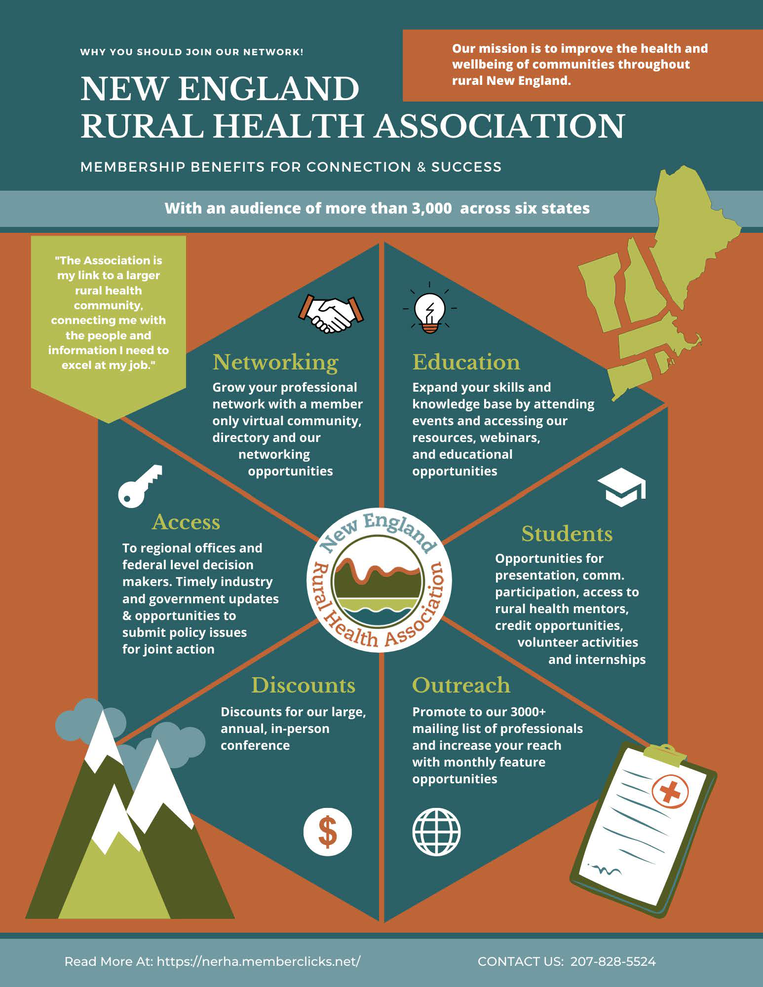

Slide 8
House Keeping:
All participants will be muted during the presentation to reduce background noise.
We will have dedicated time at the end of the presentation for Q&A and discussion
Feel free to put your questions into chat as I will be monitoring
If you have any technical difficulties or questions you can private chat to Kiera (New England Rural Health Association’s Administrative Assistant).

Slide 9
Panelists
Susan Corbett, Director of the National Digital Equity Center
Timothy M. Hesselton, Research Project Manager at the Dartmouth Centers for Health and Aging
Arlene Lugo, ATP, Program Director for the CT Tech Act Project & Assistive Technology Consultant for the Bureau of Rehabilitation Services
Patricia Richardson, Statewide Aging and Disability Resource Coordinator for the Department of Aging and Disability Services, State Unit on Aging

Slide 10
Welcome Panelist Speakers!

Slide 11
Maine Digital Inclusion Initiative
Goal: To close the Digital Divide in Maine and across the United States

Slide 12
What is Digital Equity and Digital Inclusion?
Definition: Digital Equity is a condition in which all individuals and communities have the information technology capacity needed for full participation in our society, democracy and economy.
Digital Equity is necessary for civic and cultural participation, employment, lifelong learning, and access to essential services.
Definition: Digital Inclusion includes:
Affordable Broadband
Affordable Equipment
Digital Literacy Training
Public Computer Access

Slide 13
Collaborating Partners
University of Maine
Maine State Library and 230 local libraries
Adult Education programs
Older Adult agencies
Economic Development organizations
Maine Dept. of Economic & Community Development, Maine Dept. of Labor, Maine Dept. of Education, ConnectMaine Authority
And many others

Slide 14
For Work & Business Aging Well with Technology For Home & Education
Class Offerings
Notes:
Work & Business: Microsoft Word, Excel, PowerPoint, QuickBooks, WordPress
Aging: Learning about devices, Apple, MAC Computers, Windows 10, iPads & iPhones, Android Phones & Tablets, Identifying Fraud & Scams, Getting News, Info Online, Software & Apps for Better Health, Online games for 55+
Home: Internet Safety, Online Safety for Parents of Tweens/Teens, Cloud Library, Google-Based Tools, Cutting the Cord, Requesting and Absentee Ballot, Google Classroom

Slide 15
Measuring Outcomes
Economic Opportunity:
Does digital literacy training increase workforce skills training which increase
employability?
Does it improve job seeking skills and create a more highly skilled, job ready workforce?
Does it increase access to educational attainment?
Aging-in-Place:
Can older adults remain in their homes as they grow older with the use of technology
tools?
Can it reduce isolation and loneliness?
Does the use of technology (telehealth) improve health outcomes?

Slide 16
Maine Digital Inclusion Initiative
Statistics
64% of students are 50-years and older, 27% are 70-years old and older, 8% are 80 years old and older!
42% of students have a high-school diploma or less
24% of students are unemployed
33% of students are retired
43% of students have a family median income of $34,999 or less

Slide 17
NDEC provides no cost or low cost tablets to Maine residents who are of low to moderate income. There is a limited supply. To request a device for you or someone that you know, please go to https://digitalequitycenter.org/request-device/or call (207) 259-5010.
Affordable Equipment Program

Slide 18
National Digital Equity Center
For more info:
www.digitalequitycenter.org
info@digitalequitycenter.org
207-259-5010

Slide 19
Stay Connected Project
An Effective Strategy to Reduce Social Isolation
Arlene Lugo and Patricia Richardson
Department of Aging and Disability Services

Slide 20
Social Isolation – Key Social Determinant of Health
Negative health outcomes of Social Isolation and Loneliness*
Increased risk of premature death from all causes
50% increase risk of dementia
29% increased risk of health disease & 32% increased risk of stroke
Higher rates of depression, anxiety and suicide
* https://www.cdc.gov/aging/publications/features/lonely-older-adults.html and National Academies of Sciences, Engineering, and Medicine 2020. Social Isolation and Loneliness in Older Adults: Opportunities for Health Care System. Washington, DC: The National Academies Press. https://doi.org/10.17226/25663
Notes:
Patty
As far back as 2013, long before the pandemic, loneliness and social isolation was being identified as risk factors for mortality that was comparable to other traditional clinical risk factors in a research project in the American Journal of Public Health (Published online 2013 November. doi: 10.2105/AJPH.2013.301261). The pandemic with its increased need for social distancing and risk of getting COVID-19, there were even more people experiencing the negative effects of social isolation and loneliness. One the lack of physical connection with others and loneliness more about the emotional connection with others. Recent studies have shown not only an increased risk of premature death, but a 50% increase risk of developing dementia, a 29% risk of heart disease and 32% risk of stroke with higher rates of depression, anxiety and suicide.
When the State Unit on Aging received CARES Act funds to the No Wrong Door. We used the existing Aging and Disability network to identify those most in need of intervention.

Slide 21
Effective Strategy
Screen and Connect Individuals Scoring as Social Isolated
Screen for Social Isolation during Information & Referral calls to the Aging & Disability Networks
Connect Individual to local resources
Identify the best type of AT equipment and/or software for the person with help from an AT Evaluator
Explores resource options to purchase AT equipment & internet ​
Notes:
Arlene

Slide 22
Connect & Train on use of Technology
Training & support provided by the AT Evaluator
Connections through AT
Telehealth
Evidence based programming
With friends/family
Exercise, Spiritual worship, Food shopping
Online banking
Assist with applying for funds and the purchase of recommended AT equipment
Follow-up with Social Isolation Scale
30 days post training & to additional training needs
Repeat Social Isolation Scale at 60 days
Notes:
Arlene

Slide 23
Project Partners
All Working Together
5 Area Agencies on Aging
5 Centers for Independent Living
3 Assistive Technology Partner Agencies
Various Funders
Notes:
Arlene

Slide 24
Identify Those at Risk
Screen Individuals during Information/Referral and Assistance Calls
Notes:
Patty
Area Agencies on Aging receive funding under the Older Americans Act to provide five core services to older adults aged 60 years of age or older. This includes information and referral services that all AAA provide.
Similiar to AAAs, Centers for Independent Living are not for profit agencies that also provide core services that include information and referrals services for individuals with disabilities.
We offered these ten agencies in Connecticut some additional CARES act grant funds to embed a six questions Social Isolation Scale questionnaire

Slide 25
Connect to Technology & Resources
Person Centered Approach
Who does the person want to connect to?
Preferences, strengths & special needs of the person
Which AT device & software would be best suited?
Connection to community resources
Training & support in use of AT
Follow-up
Notes:
Arlene

Slide 26
Additional Partnerships
Recommended Technology funded by:
National Family Caregiver Respite Supplemental Programs
PLAN of CT Charitable Trust Foundation
Centers for Independent Living CARES Act funds
Town of Trumbull
Bellows Fund, Jewish Family Services, Oakhill Alumni
Private pay
Department of Social Services – Medicaid Unit
All Medicaid waivers except PCA waiver had funds for technology
Notes:
Patty

Slide 27
Funding Partners
CARES Act Funding Grant | Center for Independent Living Cares Act Funding | Town of Trumbull | National Family Caregiver Supplemental Program | Private Foundation – PLAN of CT | Donation | Private Pay | Medicaid Waiver | Bellows Fund | Unknown
32 | 42 | 5 | 12 | 1 | 2 | 1 | 4 | 2 | 3
69% of AT Technology Funding came from another funding source
Notes:
Patty

Slide 28
Status of Project – Began June 28, 2020
Data as of June 3, 2021
708 older adults & persons with disabilities were screened for Social Isolation
234 met the criteria for the Stay Connected project
142 AT Consultations were completed
7 are in process for AT Consultations
63 have completed all facets of training
63 received 30-day surveys
40 received a 60-day survey
48 referred but are unable to receive training
33% scored as
Socially Isolated
Notes:
Arlene

Slide 29
Social Score Criteria
Social Isolation
Score
Criteria
6-12
Extreme Social Isolation
13-18 Social Isolation
19 – 22
High Risk for Social Isolation
23+
No Signs/Low Risk of Social Isolation
Notes:
Patty

Slide 30
Social Isolation Results Improved
Scores improved by 11.87 points at the 60 day follow-up
25.60at 60 days post training
21.80 at 30 days post training
14.38 Average Score At Referral
Notes:
Patty
Individuals were contacted 30 days after the AT training was completed and then again at 60 days. On average, individuals scored 14.5 before they referred to the AT partner and scores improved by 8.9 points after receiving technology and training. The average score at 60 days was 26.3, a score that indicates no social isolation or low risk of social isolation

Slide 31
Quality of Life at 30 & 60 days
45% rated their Quality of Life a 10 on a scale of 1-10
77% rated their Quality of Life as 5 or better on a scale of 1-10
Notes:
Patty
More importantly, at 30 and 60 days, 45% of those surveyed at 30 & 60 days rated their Quality of Life as a 10 out of 1-10 with 77% rating it at least 5 or better.

Slide 32
Social Interactions
Rating of Social Interactions increased after receiving technology & training
Less than Usual
3.23% N=1
About the Same
29.03% N=9
More than Usual
67.74% N=21
Notes:
Patty

Slide 33
Social Interactions at 30 days
58.73% strongly agreed their relationships are fulfilling
22.22% somewhat agreed
Notes:
Patty

Slide 34
Use of Technology
68.25% use their technology every day
26.98% use it once or a few times a week
Notes:
Arlene

Slide 35
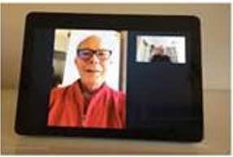
Success Story
A caregiver scored as being socially isolated
Limited time away from home – due to caregiving for her husband who had many medical conditions
She loved the drop-in feature with video check to ensure her husband was okay when she was in another room or out of the house
An AT Consultation was conducted by phone
Recommendation: Amazon Echo Show 10”
Funding by: The National Family Caregiver Supplemental Program
Notes:
Arlene

Slide 36
Success Story Results:
The Amazon Show was positioned so he can see it from his bed.
The caregiver loved the drop-in feature with video to check in to ensure her husband was okay when she was in another room or out of the house
Family sends him photos for the running slide show
He can watch videos & listen to music
He can make and answer phone calls using his voice
Has access to emergency help, if needed
Notes:
Arlene

Slide 37
Lessons Learned Providing Telehealth “Kits” to Older Adults during the COVID-19 Pandemic
Timothy Hesselton, MPH
Research Project Manager
Dartmouth Centers for Health and Aging
Dartmouth-Hitchcock Health
Timothy.M.Hesselton@Hitchcock.org

Slide 38
Funding
This program is supported by the Health Resources and Services Administration (HRSA) of the U.S. Department of Health and Human Services (HHS) as part of an award totaling $90,625 with 0% financed with nongovernmental sources. The contents are those of the author(s) and do not necessarily represent the official views of, nor an endorsement, by HRSA, HHS, or the U.S. Government.

Slide 39
What is GWEP?
The Geriatric Workforce Enhancement Program (GWEP) is designed to educate the healthcare workforce in best practices for delivering care to older adults
Funded by the Health Resources and Services Administration (HRSA)

Slide 40
GWEP COVID Supplement
This supplement was provided by HRSA in response to the COVID-19 pandemic
The primary focus of this supplement is to provide Telehealth “kits” to older adult patients on a temporary basis to facilitate video-based Transitional Care Management Visits (transitions from inpatient hospitalization to community setting)
Kits Include:
Cellular enabled iPad
Thermometer
Pulse-oximeter
Blood pressure cuff
Training Manual

Slide 41
GWEP Telehealth Kit Process - Overview
Inpatient Care Management
GWEP Team
Outpatient Care Coordination / Primary Care
Meets inclusion criteria/ consents
Provide kit, signed agreement, myDH setup
Patient Nearing Discharge
Yes
Distribute kits weekly to inpatient
Verify consent, troubleshoot, track for pickup
Survey, incentive, kit return
Kit return & sanitization
No
Usual Care
Follow-up TCM “call” with care coordinators via iPad
TCM Visit with PCP/ care team

Slide 42
Inclusion Criteria
Heater Road Primary Care patient
Age 65 and older
For Transitional Care Management: Discharge rises to the level of needing post-discharge follow-up visit (high or moderate complexity)
Lives within ~30-minute range of Lebanon, NH
Patient consents to process

Slide 43
Results
Difficulty getting off the ground
Piloted kits and manuals with 5 older adult volunteers
Total of 12 patients offered kits
4 kits were distributed, 2 of which were used to facilitate Telehealth visits

Slide 44
Implementation Barriers
Identifying Project Champion
Competing Priorities
Discharge includes numerous other components
Few eligible patients
Acuity of patient illness
Tepid engagement from staff
Low staff confidence in video-based care

Slide 45
Patient Access Barriers
Stress of discharge
Preference/Need for in-person visits
Caregiver support needed
Training retention
Lack of confidence using technology
Training manual too cumbersome
Limited internet/cellular access

Slide 46
Lessons Learned
Establish inpatient AND outpatient champions early
Open to additional clinics/providers/units
Post-discharge distribution
In-person device training
Provide kits for visits other than transitions of care
Provide “jetpack” in addition
Older adult pilot KEY

Slide 47
Future Directions
Longer distribution time, wider scope
Older adult attitudes using telemedicine
Provider attitudes on older adults using telemedicine
Chromebooks vs. tablets
Cost savings

Slide 48
Questions?
Contact Info Below
Timothy Hesselton, MPH
Research Project Manager
Dartmouth Centers for Health and Aging
Dartmouth-Hitchcock Health
Timothy.M.Hesselton@Hitchcock.org
Arlene Lugo
Arlene.Lugo@ct.gov
Patricia Richardson
Patricia.Richardson@ct.gov
Susan Corbett
For more info:
susan@digitalequitycenter.org
www.digitalequitycenter.org
info@digitalequitycenter.org
207-259-5010

Slide 49
Consider Joining us at the New England Rural Health Association!
We work hard to advocate, educate, communicate, and collaborate, all to improve rural health in the New England region.
We would love to have you join us and our other members to come together, network, and work toward a better tomorrow in our communities.

Slide 50
Register Now!

Slide 51
Thank You Again To Our Sponsors!

Slide 52
Thank you for attending!

